Slide 1
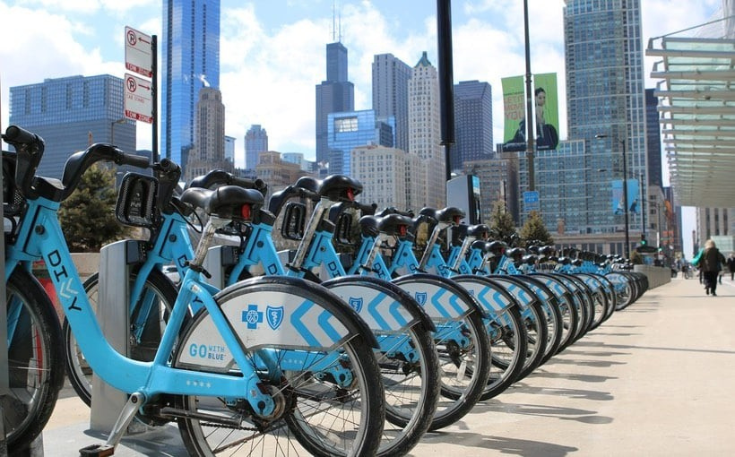


CYCLIST
CASE STUDY
GOOGLE DATA ANALYTICS CAPSTONE PROJECT
BY AYUSH DIMRI

Slide 2

BUSINESS OBJECTIVE
Identifying How do annual members and casual riders use Cyclist bikes differently
How to pursue casual riders to become annual members

Slide 3

DATA SET USED
Divvy-trip data source has been used to carry out the analysis, the data has been made available by motivate International Inc
Data set contains the detail of all riders in 2021

Slide 4

DATA INTEGRITY
Data set has high integrity due to its origin from first party Data Source
still some minor error like null values are present In the data set
Data set also contains some data that is irrelevant for the analysis

Slide 5


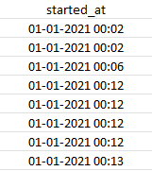
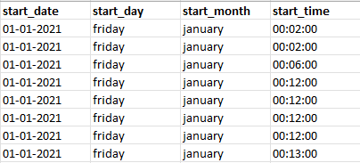

DOCUMENTATION OF DATA CLEANING
Deleted some useless columns
Transformed the data so that it meets requirement of analysis

Slide 6
MEMBERS VS CASUAL RIDERS
There are more Members than Casual Riders
Members outnumber casual riders by 540000
Members exceed Casual Rider by 10%

Slide 7
BIKE USAGE BREAKDOWN
Classic Bikes are more Preferred than Electric and Docked Bike
Classic Bikes cover more than 50% of total Bike usage
Docked Bike are least preferred with only 6% usage rate
Electric Bike cover 36% of total bike usage

Slide 8
RIDERS PER DAY
Casual
Member
Members use Bikes more in Weekdays
Casual Riders tend to use Bikes more in Weekends

Slide 9
RIDERS PER MONTH
Most riders in July and Least riders in month of February
Total riders tend to increase in summer season

Slide 10
RIDERS PER SEASON
Summer season is preferred by majority of the riders
Total number of riders shows a big fall down in winter season.
Preference of riders to ride drops to almost half in spring, one sixth of the fraction remain on winter and 3/4th in autumn compared to summer.
SPRING
SUMMER
AUTUMN
WINTER

Slide 11
AVERAGE RIDE LENGTH
Casual riders have approximately 2 times more average ride length then members
Average ride length of casual riders → 27 mins
Average ride length of members → 14 mins
Members are more consistent compared to casual riders

Slide 12
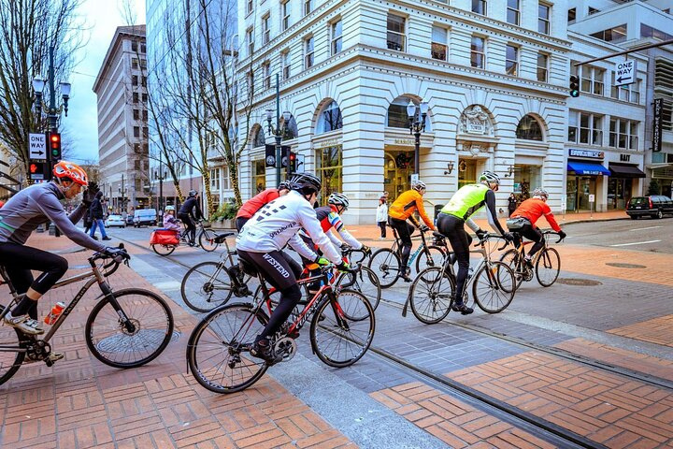
1
Classic bikes are more preferred then electric and docked bikes
2
Weekends are more preferred by casual riders and weekdays are more preferred by members
3
Riders prefer to ride more in summer season and we see a big downfall in winter season
CONCLUSION

Slide 13

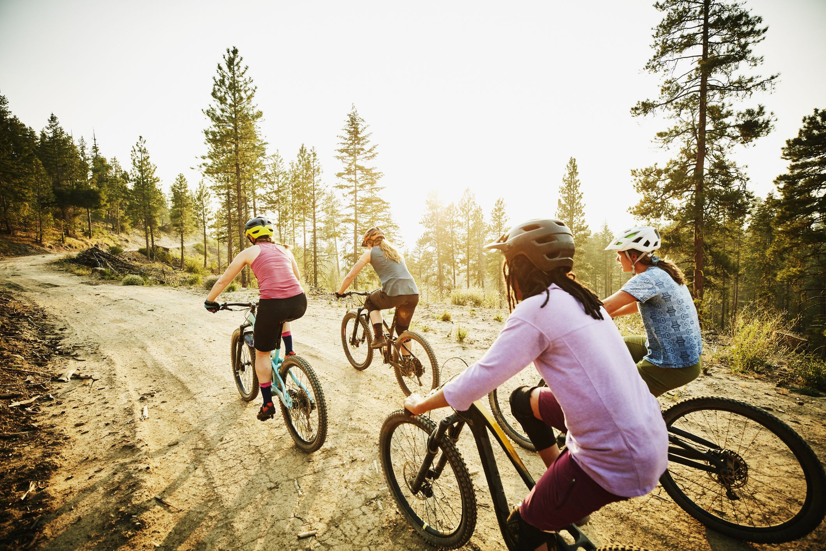
1
Create a classic bike yearly membership pass where a riders can use classic bikes as much as they want
2
Create a weekend yearly membership pass where a rider can enjoy
Unlimited rides in weekends
3
Create a summer season yearly membership pass where a rider can enjoy unlimited rides in summer season
RECOMMENDATIONS

Slide 14
THANK YOU

